Slide 1


Deep Neural Networks (DNNs) for Object Detection
By
700760007

Slide 2

Motivation:-
To improve object detection using DNNs by addressing the challenge of not only classifying objects in images but also precisely locating them.
Traditional methods like Deformable Part-based Models (DPM) have been effective but depends on manually engineered features.
DNNs offer complex features directly from data, which can enhance both classification accuracy and object localization precision.
This approach makes it easier and more accurate to find objects of different sizes in images.

Slide 3
Problem statement:-
limitation of traditional methods in object detection, specifically in accurately localizing objects within images.
Challenges in achieving precise object localization for objects at different scales and orientations.
So, by using Deep Neural Networks (DNNs), which are good at learning patterns and features from data on their own.
The goal is to create a method that boosts both the accuracy of classifying objects and finding their locations in images.

Slide 4
Objectives:-
Enhance Object Detection Accuracy: Creates a method using DNN to achieve better object detection accuracy than traditional methods such as Deformable Part-based Models (DPM).
Improve Localization Precision: Work on increasing the accuracy of locating objects within images, especially those that vary in size and orientation.
Utilize Deep Learning Techniques: Using DNNs to automatically learn and extract intricate features from data, for a more accuracy.
Achieve State-of-the-Art Performance: To reach the best performance in object detection tasks, focusing on both high classification accuracy and bounding box localization.

Slide 5
Contributions:-
Proposal of Deep Learning Approach: Introducing deep learning-based framework for object detection that outperforms traditional methods like Deformable Part-based Models (DPM).
Enhanced Accuracy and Precision: Paper shows significant improvements in object detection accuracy and localization precision compared to existing methods.
Feature Representation: By using DNNs it automatically learn and extract complex features from images, the ability to recognize objects improves.
Practical Application: Providing a practical and scalable solution for object detection that can be used in many fields, helping advance computer vision research and applications.

Slide 6
Dataset and Evaluation:-
Dataset Used:-
Test Set: Pascal Visual Object Challenge (VOC) 2007 with approx. 5000 test images over 20 classes.
Training Set: VOC2012 training and validation set with approx. 11K images due to the large number of parameters in the proposed approach.
Performance Metrics:-
Precision-Recall Curves: Used to measure the performance.
Average Precision (AP) per Class: Specific measure used for evaluation.

Slide 7

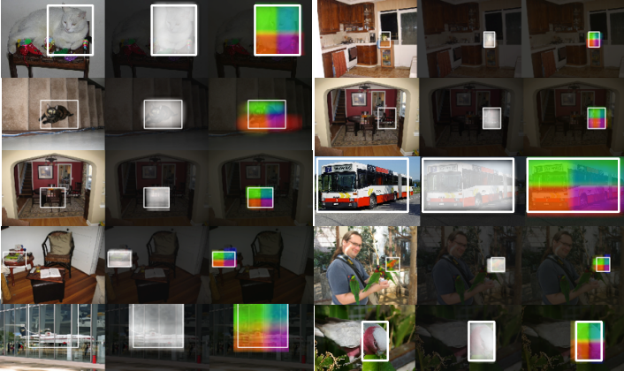



Results:-
The first one corresponds to the output of DNN, while the second one encodes the four partial masks in terms of the strength of the color's red, green, blue and yellow

Slide 8

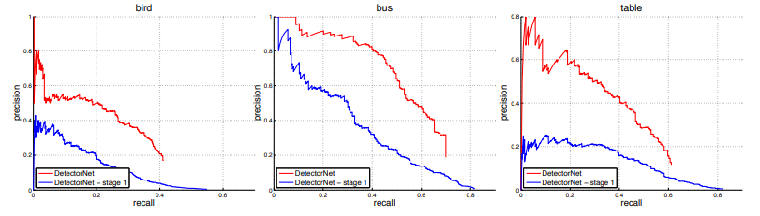


Results:-
Precision-recall Curves Showing Improvement Post-refinement
Precision is the ratio of the number of true positives to the total number of positive predictions.
For example, if the model detected 100 trees, and 90 were correct, the precision is 90 percent.
Recall is the ratio of the number of true positives to the total number of actual (relevant) objects.

Slide 9
Critical Analysis:-
Advantages:-
The use of DNNs allows for learning rich and complex feature representations directly from data, eliminating the need for manual feature engineering.
By applying the DNN at multiple scales and refining the predictions, the authors achieve high localization accuracy.
Limitations:-
Applying the DNN multiple times for each image can still be resource-intensive, especially for large datasets or real-time applications.
The approach may struggle with objects that are heavily occluded or have very similar appearances to their surroundings

Slide 10

Reference:-
Szegedy, C., Toshev, A., & Erhan, D. (2013). Deep neural networks for object detection. Retrieved from https://www.researchgate.net/publication/319770289_Deep_Neural_Networks_for_Object_Detection

